Slide 1
L06 - Concepts and concept location
Initiation
Also known as feature location
Concept Location
Impact Analysis
V
E
R
I
F
I
C
A
T
I
O
N
Prefactoring
Actualization
Postfactoring
Conclusion
© 2012 Václav Rajlich Software Engineering: The Current Practice Ch. 6

Slide 2

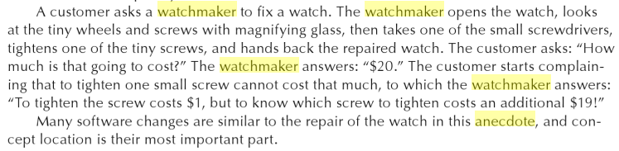
© 2012 Václav Rajlich Software Engineering: The Current Practice Ch. 6

Slide 3
Role of concept location
Concept location finds code snippet where a change is to be made
  this is the start of the change
Change requests are most often formulated in terms of domain concepts
  Domains: e.g., university, bank
  Example: “Correct error that arises when trying to add a course”
  Must find in the code the locations where concept “add course” is located
© 2012 Václav Rajlich Software Engineering: The Current Practice Ch. 6

Slide 4
Partial comprehension of a code
Large programs cannot be completely comprehended before a change is made
  programmers seek the minimum essential understanding for the particular software task
  often use an as-needed strategy
  attempt to understand how certain specific concepts are reflected in the code
Analogy: visiting a large city
  Bremen Germany visit last week
© 2012 Václav Rajlich Software Engineering: The Current Practice Ch. 6

Slide 5
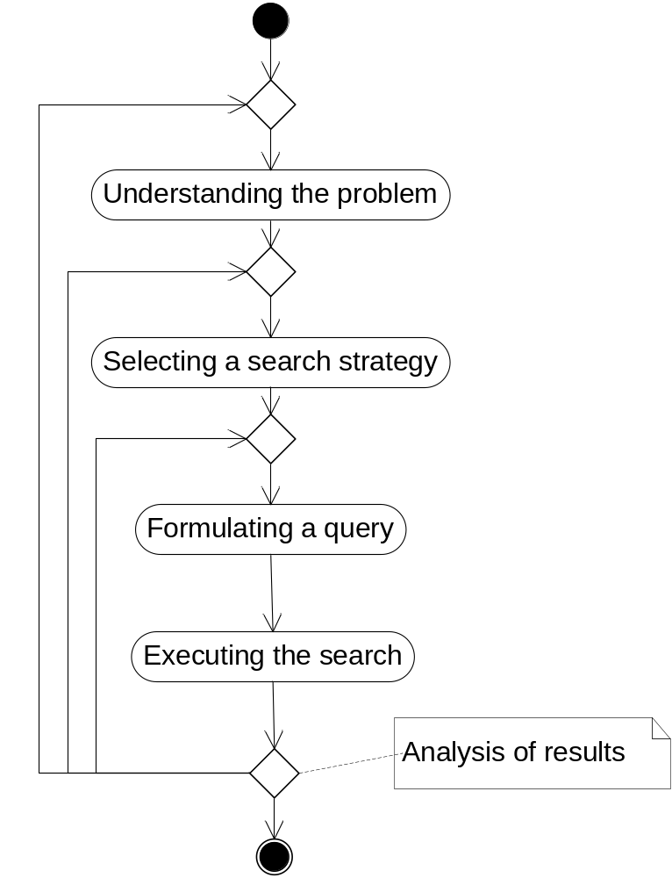
Search in the unknown parts of system
© 2012 Václav Rajlich Software Engineering: The Current Practice Ch. 6
Notes:
Problem: finding a restaurant
Strategies: look around for signs of a restaurant, or ask someone

Slide 6
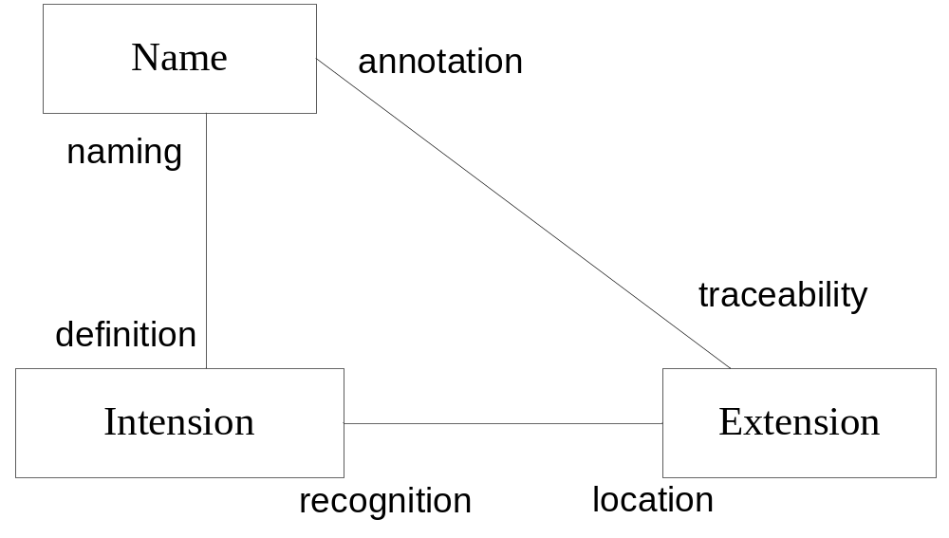
Concept triangle
© 2012 Václav Rajlich Software Engineering: The Current Practice Ch. 6
Notes:
http://www.britannica.com/topic/intension
Alternative titles: comprehension; connotation
Intension and extension, in logic, correlative words that indicate the reference of a term or concept: “intension” indicates the internal content of a term or concept that constitutes its formal definition; and “extension” indicates its range of applicability by naming the particular objects that it denotes. For instance, the intension of “ship” as a substantive is “vehicle for conveyance on water,” whereas its extension embraces such things as cargo ships, passenger ships, battleships, and sailing ships. The distinction between intension and extension is not the same as that between connotation and denotation.

Slide 7
Spelling corner (Merriam-Webster)
Intension \in-’ten(t)-shən\
  synonym CONNOTATION
    the suggesting of a meaning by a word apart from the thing it explicitly names or describes b: something suggested by a word or thing — W. R. Inge> an essential property or group of properties of a thing named by a term in logic
Intention \in-’ten(t)-shən\
  synonyms INTENT , PURPOSE , DESIGN , AIM , END , OBJECT , OBJECTIVE, GOAL mean what one intends to accomplish or attain.
    INTENTION implies little more than what one has in mind to do or bring about <announced his intention to marry>. . .
© 2012 Václav Rajlich Software Engineering: The Current Practice Ch. 6

Slide 8



Dog as an example
<<extensions >>
<<name>>
Dog / Pes / Hound
Fido
Lassie
Buck (in “Call of the wild” by Jack London)
<<intension >>
Hairy animal with teeth…
© 2012 Václav Rajlich Software Engineering: The Current Practice Ch. 6

Slide 9
Concept location
Concept extensions are implemented as code fragments
  variables, classes, methods, or other
Programmers finds these code fragments
  easy in small programs or in the programs that the programmer knows well
  hard in large programs or programs that the programmer does not know
    Watchmaker anecdote
© 2012 Václav Rajlich Software Engineering: The Current Practice Ch. 6

Slide 10
Formulating a query
Extract the set of concepts used in the change request
Delete the concepts intended for the communication with the programmers
Delete the concepts that are unlikely to be implemented in the code
  concepts related to the things that are outside of the scope of the program
  concepts that are to be implemented in the future.
Rank the remaining concepts by the likelihood that they can be easily located
© 2012 Václav Rajlich Software Engineering: The Current Practice Ch. 6

Slide 11
Example
Point of Sale system
Change request is “Implement a credit card payment”
Identify the concepts
  “Implement”
  “Credit card”
  “Payment”
© 2012 Václav Rajlich Software Engineering: The Current Practice Ch. 6

Slide 12
Example
Point of Sale system
Change request is “Implement a credit card payment”
Identify the concepts
  “Implement” … communication with programmer
  “Credit card”
  “Payment”
© 2012 Václav Rajlich Software Engineering: The Current Practice Ch. 6

Slide 13
Example
Point of Sale system
Change request is “Implement a credit card payment”
Identify the concepts
  “Implement” … communication with programmer
  “Credit card” … to be implemented, not in the
  old code
  “Payment”
© 2012 Václav Rajlich Software Engineering: The Current Practice Ch. 6

Slide 14
Example
Point of Sale system
Change request is “Implement a credit card payment”
Identify the concepts
  “Implement” … communication with programmer
  “Credit card” … to be implemented,
  not in the old code
  “Payment” !!! Significant concept,
  look for it in the code
© 2012 Václav Rajlich Software Engineering: The Current Practice Ch. 6

Slide 15
Concept location methodologies
Human knowledge
Traceability tools
Dynamic search (execution traces)
Static search
  "grep" (pattern matching)
  information retrieval techniques (google)
  dependency search
© 2012 Václav Rajlich Software Engineering: The Current Practice Ch. 6

Slide 16
Concept location by grep
Classical technique for concept location
  based on pattern matching
Programmer formulates a query
  based on concept name(s)
Grep searches the files
  finds corresponding lines of code (“hits”)
  programmer investigates the hits
If a search fails, new query is tried
  programmer learns from failed search
© 2012 Václav Rajlich Software Engineering: The Current Practice Ch. 6

Slide 17
GREP Search Technique
GREP is an acronym for "global regular expression print".
  GREP prints out the lines that contain a match for a regular expression.
  Programmer iteratively formulates search query and then investigates the results.
  If the results are too big to review, programmer either performs further search within these results or reformulates the search query.
© 2012 Václav Rajlich Software Engineering: The Current Practice Ch. 6

Slide 18
Example: “Anchors” bug in Mozilla*
Change request
  Anchors in e-mails are broken (Clicking Anchor doesn't go to target in e-mail)
Initial knowledge
*M. Petrenko, V. Rajlich, R. Vanciu, “Partial Domain Comprehension in Software Evolution and Maintenance”, ICPC 2008, 13-22
E-mail
typeOf
HTML document
partOf
partOf
HTML fragment
Anchor
Targets
© 2012 Václav Rajlich Software Engineering: The Current Practice Ch. 6

Slide 19
Knowledge after learning
Result of repeated search
  Programmer learns from the searches
E-mail
typeOf
HTML document
partOf
partOf
HTML fragment
Anchor
propertyOf
Targets
Winning grep query: mailbox: //
URI
partOf
“mailbox: //"
© 2012 Václav Rajlich Software Engineering: The Current Practice Ch. 6

Slide 20
Example: Art of Illusion
3D modeling studio, written in Java
More than 600 classes, 100,838 LOC.
Implement a zooming control
  currently, the only way to zoom is to enter the zooming value into the specific text box
    a value of the zoom has to be typed in by the user
    the default value is 100%.
  implement zooming control that uses arrow keys
© 2012 Václav Rajlich Software Engineering: The Current Practice Ch. 6

Slide 21
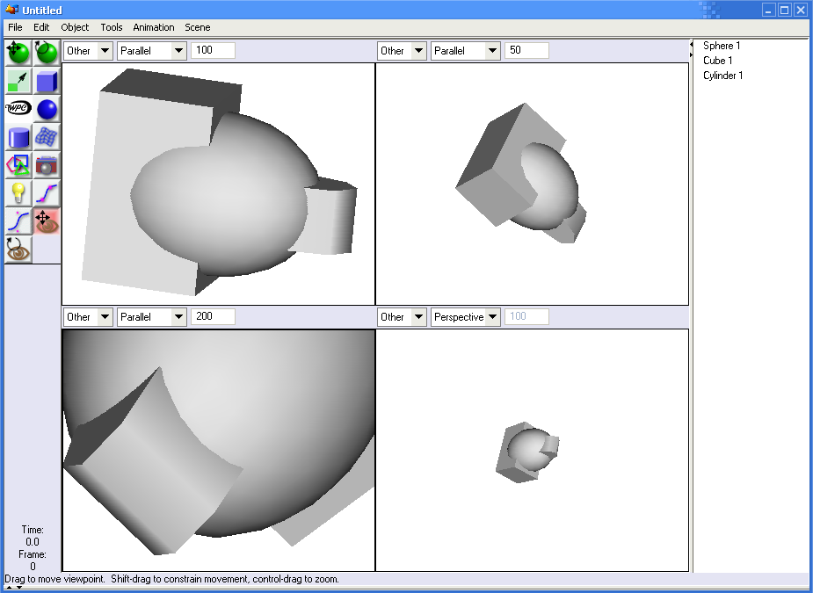
Art of Illusion
© 2012 Václav Rajlich Software Engineering: The Current Practice Ch. 6

Slide 22
GREP example
First search: “zoom”
  The query produced irrelevant 6 lines
Second search: “scale”
  returned in 1,544 lines, too large for inspection.
Third search: “100”
  default scaling value is 100
  search within the results of the previous search
  returned 4 lines from the ViewerCanvas.java file.
Inspection
  one of the lines is the location
© 2012 Václav Rajlich Software Engineering: The Current Practice Ch. 6

Slide 23
Dependency Search Technique
Uses Class Dependency Graphs (CDG)
  extracted form the existing code
Local functionality
  consists of concepts that are actually implemented in the module and are not delegated to others.
Composite functionality
  as the complete functionality of a module combined with all its supporting modules.
Determined by reading code and documentation
© 2012 Václav Rajlich Software Engineering: The Current Practice Ch. 6

Slide 24

Functionalities of component X
Concept A
Component X
Local
responsibility
Concept B
…
Composite responsibility
© 2012 Václav Rajlich Software Engineering: The Current Practice Ch. 6

Slide 25
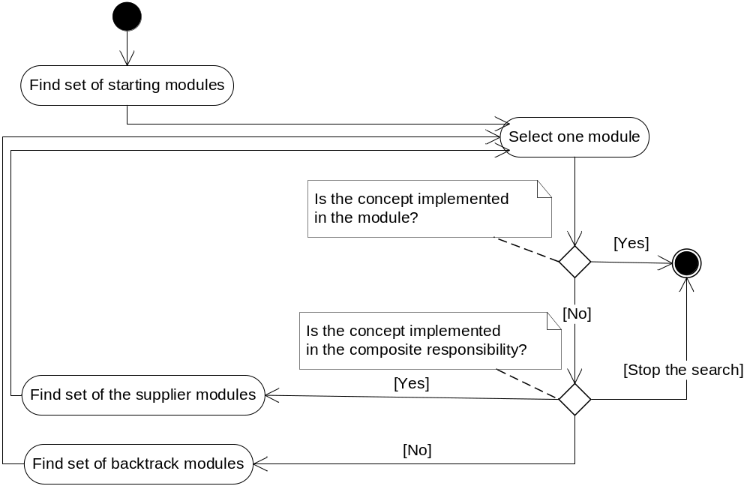
Concept location by dependency search
© 2012 Václav Rajlich Software Engineering: The Current Practice Ch. 6

Slide 26
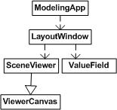
Progress of the search
© 2012 Václav Rajlich Software Engineering: The Current Practice Ch. 6

Slide 27
Dependency search part 1
Start at the ModelingApp class
  concept not contained within its local responsibility
The next step: inspect LayoutWindow
  responsible for constructing the main AOI window
  composite responsibility contains the concept, but the local responsibility does not.
There were clues to search ValueField
  it implements the text box.
  concept is not present in the composite responsibility
  backtrack to the LayoutWindow class
© 2012 Václav Rajlich Software Engineering: The Current Practice Ch. 6

Slide 28
Dependency search part 2
The SceneViewer class
  several functions are responsible for responding to events from the user
  function updateImage() was responsible for repainting the screen
  we determined that the composite responsibility of this function contained the concept.
  local responsibility of SceneViewer still did not contain the concept
ViewerCanvas class
  contains the concept
© 2012 Václav Rajlich Software Engineering: The Current Practice Ch. 6

Slide 29
Comparison of the Techniques
The grep-based
  depends on the use of naming conventions
  independent of class structure
    GREP tools provide just the list of search results
  suitable for explicit concepts only
The static dependency search technique
  utilizes the class structure
  needs correct understanding of composite and local functionality
  suitable for both explicit and implicit concepts
© 2012 Václav Rajlich Software Engineering: The Current Practice Ch. 6
Notes:
Speaking about different techniques,

Slide 30
Example Violet
Violet
  Open source UML editor
Supports drawing UML Diagrams
  Class diagram, Sequence diagram, State diagram, Object diagram, Use case diagram
60 classes and 10,000 lines of code
  http://sourceforge.net/projects/violet/
© 2012 Václav Rajlich Software Engineering: The Current Practice Ch. 6

Slide 31
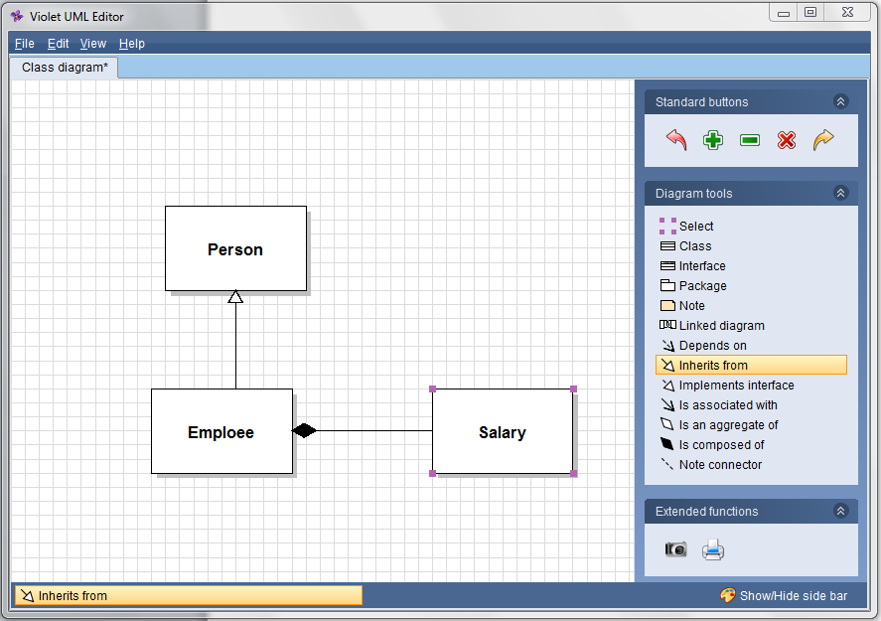
GUI of Violet
© 2012 Václav Rajlich Software Engineering: The Current Practice Ch. 6

Slide 32
Change Request
Record the author for each class symbol in the class diagrams
This change will make Violet more versatile
  support for cooperative work
  the author created a figure
    author knows the semantics of the figure
Name of concept: “author”
  implicit concept extension
    the extension is not present in the current code
  belongs to the set of the figure properties
© 2012 Václav Rajlich Software Engineering: The Current Practice Ch. 6

Slide 33
Status of components (marks)
Blank | The class was never inspected and is not scheduled for an inspection.
Propagating | The programmers inspected the class and found that its composite responsibility contains the concept
Unchanged | The programmers inspected the class and found that its composite responsibility does not contain the concept
Next | The class is scheduled for inspection
© 2012 Václav Rajlich Software Engineering: The Current Practice Ch. 6

Slide 34
Locating figure properties: Start
UMLEditor
SequenceDiagram
Graph
UseCaseDiagram
Graph
ClassDiagram
Graph
ObjectDiagram
Graph
StateDiagram
Graph
ClassRelationship
Edge
PackageNode
ClassNode
InterfaceNode
NoteNode
MultiLineString
RectangularNode
AbstractNode
© 2012 Václav Rajlich Software Engineering: The Current Practice Ch. 6

Slide 35
Classes to inspect
UMLEditor
SequenceDiagram
Graph
UseCaseDiagram
Graph
ClassDiagram
Graph
ObjectDiagram
Graph
StateDiagram
Graph
ClassRelationship
Edge
PackageNode
ClassNode
InterfaceNode
NoteNode
MultiLineString
RectangularNode
AbstractNode
© 2012 Václav Rajlich Software Engineering: The Current Practice Ch. 6

Slide 36
Most likely supplier
UMLEditor
SequenceDiagram
Graph
UseCaseDiagram
Graph
ClassDiagram
Graph
ObjectDiagram
Graph
StateDiagram
Graph
ClassRelationship
Edge
PackageNode
ClassNode
InterfaceNode
NoteNode
MultiLineString
RectangularNode
AbstractNode
© 2012 Václav Rajlich Software Engineering: The Current Practice Ch. 6

Slide 37
Next classes to inspect
UMLEditor
SequenceDiagram
Graph
UseCaseDiagram
Graph
ClassDiagram
Graph
ObjectDiagram
Graph
StateDiagram
Graph
ClassRelationship
Edge
PackageNode
ClassNode
InterfaceNode
NoteNode
MultiLineString
RectangularNode
AbstractNode
© 2012 Václav Rajlich Software Engineering: The Current Practice Ch. 6

Slide 38
Wrong way
UMLEditor
SequenceDiagram
Graph
UseCaseDiagram
Graph
ClassDiagram
Graph
ObjectDiagram
Graph
StateDiagram
Graph
ClassRelationship
Edge
PackageNode
ClassNode
InterfaceNode
NoteNode
MultiLineString
RectangularNode
AbstractNode
© 2012 Václav Rajlich Software Engineering: The Current Practice Ch. 6

Slide 39
Backtrack
UMLEditor
SequenceDiagram
Graph
UseCaseDiagram
Graph
ClassDiagram
Graph
ObjectDiagram
Graph
StateDiagram
Graph
ClassRelationship
Edge
PackageNode
ClassNode
InterfaceNode
NoteNode
MultiLineString
RectangularNode
AbstractNode
© 2012 Václav Rajlich Software Engineering: The Current Practice Ch. 6

Slide 40
Concept location found
UMLEditor
SequenceDiagram
Graph
UseCaseDiagram
Graph
ClassDiagram
Graph
ObjectDiagram
Graph
StateDiagram
Graph
ClassRelationship
Edge
PackageNode
ClassNode
InterfaceNode
NoteNode
MultiLineString
RectangularNode
AbstractNode
© 2012 Václav Rajlich Software Engineering: The Current Practice Ch. 6

Slide 41
Possible extension of the search
UMLEditor
SequenceDiagram
Graph
UseCaseDiagram
Graph
ClassDiagram
Graph
ObjectDiagram
Graph
StateDiagram
Graph
ClassRelationship
Edge
PackageNode
ClassNode
InterfaceNode
NoteNode
MultiLineString
RectangularNode
AbstractNode
© 2012 Václav Rajlich Software Engineering: The Current Practice Ch. 6

Slide 42
Another location found
UMLEditor
SequenceDiagram
Graph
UseCaseDiagram
Graph
ClassDiagram
Graph
ObjectDiagram
Graph
StateDiagram
Graph
ClassRelationship
Edge
PackageNode
ClassNode
InterfaceNode
NoteNode
MultiLineString
RectangularNode
AbstractNode
© 2012 Václav Rajlich Software Engineering: The Current Practice Ch. 6

Slide 43
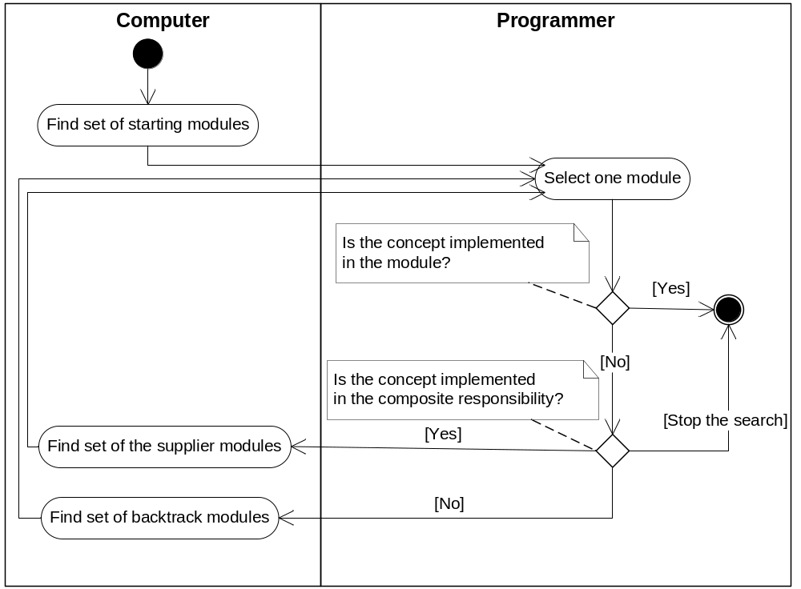
Interactive tool for concept location
© 2012 Václav Rajlich Software Engineering: The Current Practice Ch. 6

Slide 44
Example 2: Eclipse 3.3
Eclipse – Integrated Development Environment for Java
15,479 classes, 156,334 functions
Change request: BugID 172261*: [Actions] When rename a file in one project’s navigator, the other selected file’s name is renamed
*https://bugs.eclipse.org/bugs/show_bug.cgi?id=172261
© 2012 Václav Rajlich Software Engineering: The Current Practice Ch. 6

Slide 45
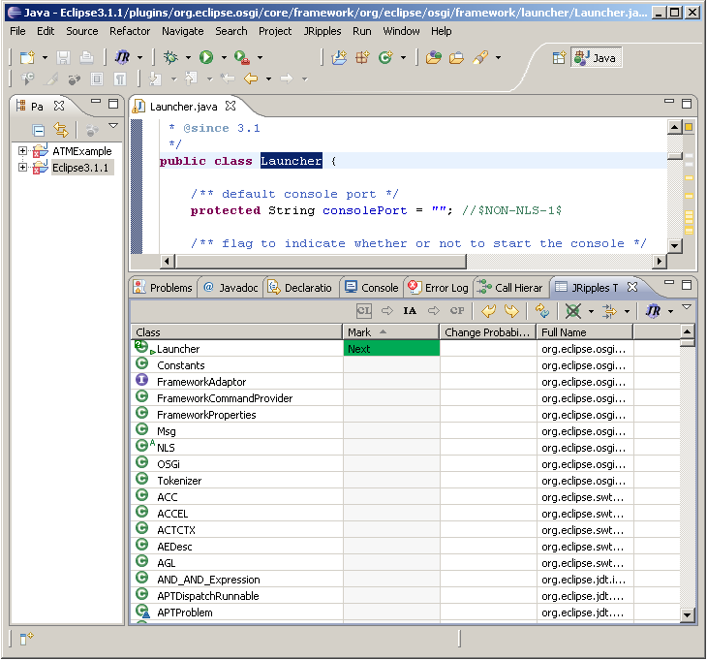

Dependency search in Eclipse
© 2012 Václav Rajlich Software Engineering: The Current Practice Ch. 6

Slide 46
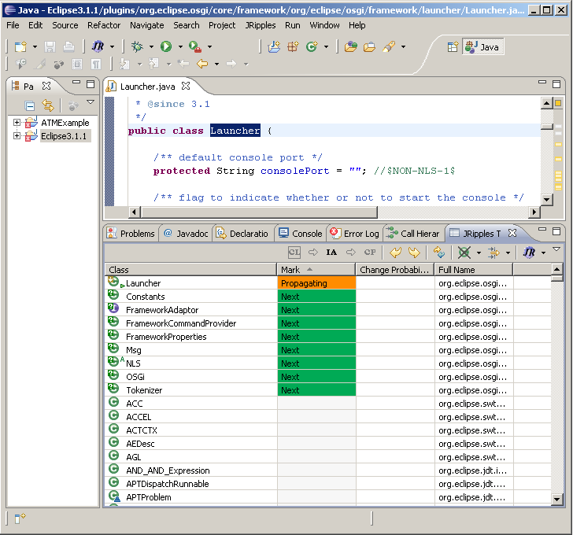






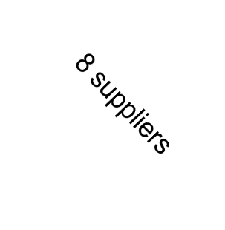



Dependency search in Eclipse
FrameworkCommandProvider
NLS
MSG
© 2012 Václav Rajlich Software Engineering: The Current Practice Ch. 6

Slide 47
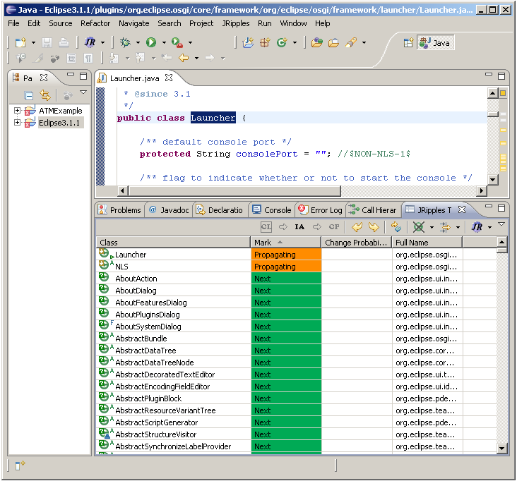








Dependency search in Eclipse
© 2012 Václav Rajlich Software Engineering: The Current Practice Ch. 6

Slide 48
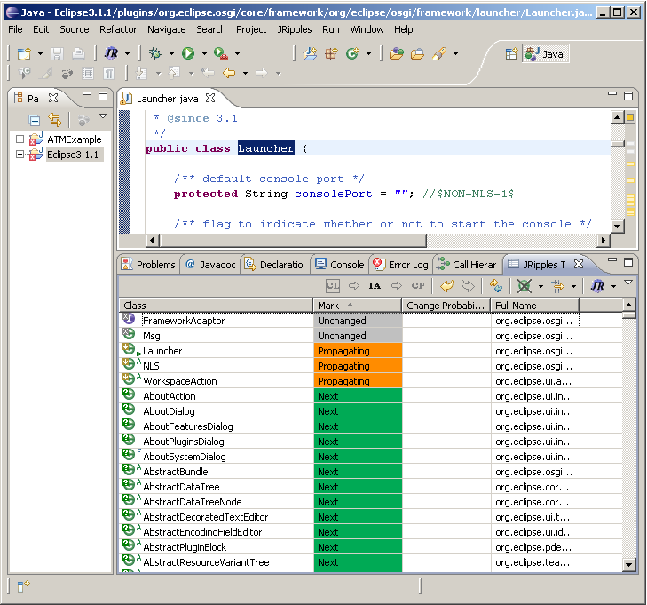



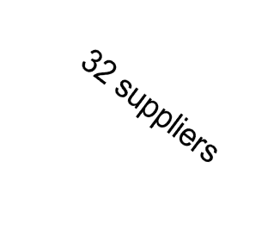

Dependency search in Eclipse
© 2012 Václav Rajlich Software Engineering: The Current Practice Ch. 6

Slide 49
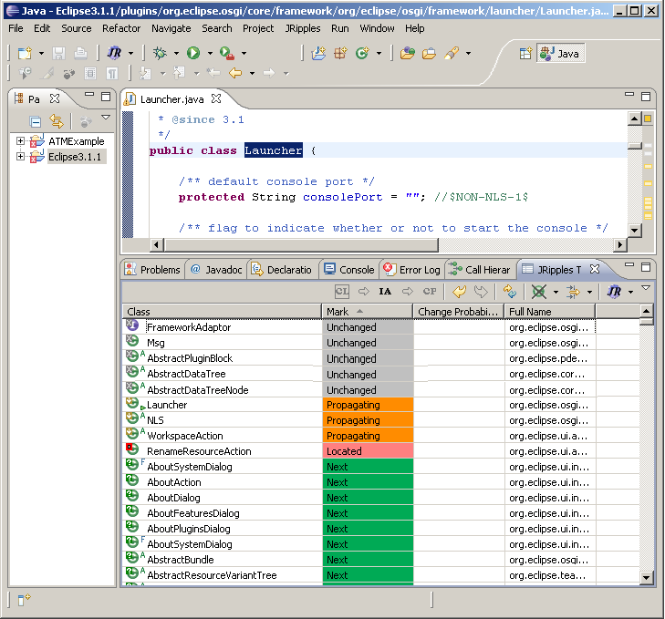

Dependency search in Eclipse
© 2012 Václav Rajlich Software Engineering: The Current Practice Ch. 6

Slide 50
Results
Main class: Launcher
Minimum possible number of classes visited = 4
Maximum number of classes to be visited =1076 (1+8+1035+32)
Developers have to use heuristics or intuition when there are too many suppliers
© 2012 Václav Rajlich Software Engineering: The Current Practice Ch. 6

